Slide 1
Lecture
Excel: Macros &
Pivot Tables

Slide 2
Macros
A macro is a series of commands that are stored and can be run whenever you need to perform the task

Slide 3
Macros, cont.
Set of instructions that can be automated within Excel
Purpose is to eliminate repetitive tasks as well as simplify
Examples include adding or deleting rows or columns; adding a specific header; adding the date to a sheet

Slide 4
Security
Viruses can be attached to macros
Security settings have to be set to enable macros to run
Ensure you know it’s your file or from a trusted source before enabling

Slide 5
Create a New Macro
Macros are created from the View or Developer tab
Actions can be recorded and then RUN in other sheets and workbooks

Slide 6
Two Ways
There are two ways to create a macro
The recordable option offers an easier interface for users to create Macros without needing to know the underlying VBA (Visual Basic for Applications) code
The second option allows users to code directly utilizing VBA

Slide 7
Editing
Even when macros have been recorded, users can edit the underlying VBA code to adjust colors, change ranges, update a function, etc.

Slide 8
Editing Macros –
Visual Basic Editor
Sub Sum()
Sum Macro'
Range("N5").Select
ActiveCell.FormulaR1C1 = "=SUM(RC[-12]:RC[-1])"
Range("N5").Select
Selection.AutoFill Destination:=Range("N5:N7"), Type:=xlFillDefault
Range("N5:N7").Select
Range("B8").Select
ActiveCell.FormulaR1C1 = "=SUM(R[-3]C:R[-1]C)"
Range("B8").Select

Slide 9
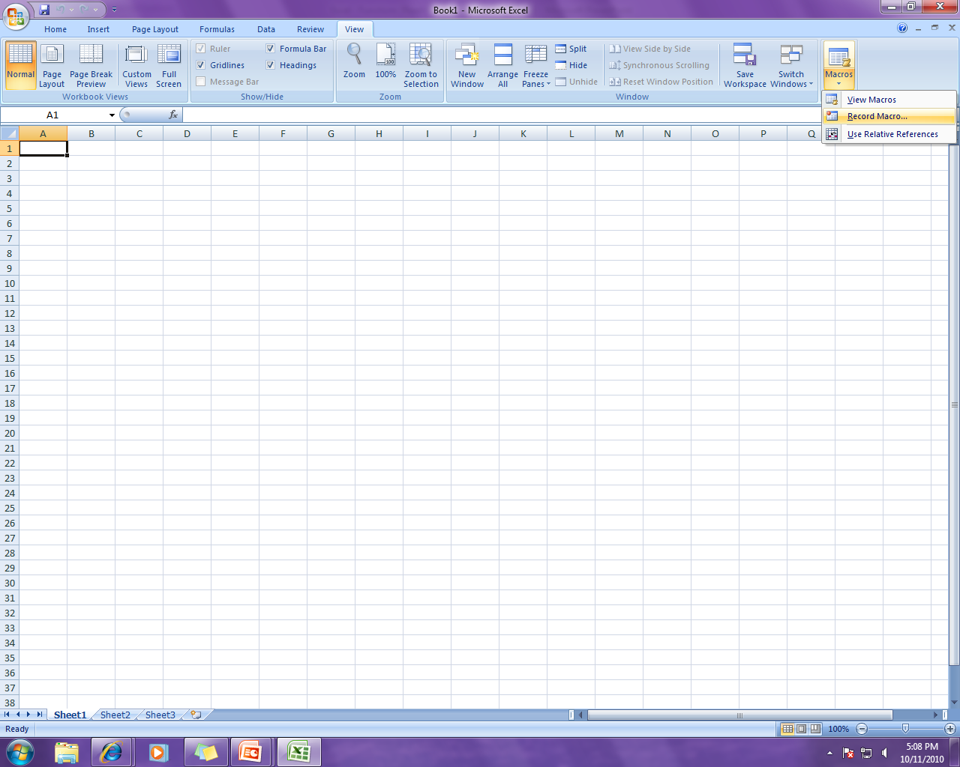
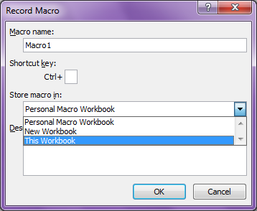
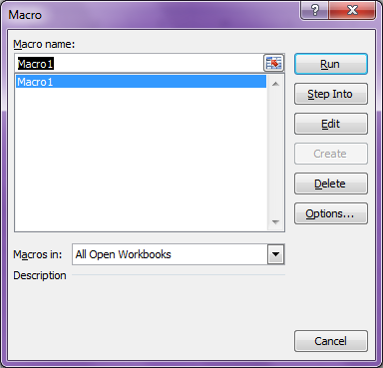
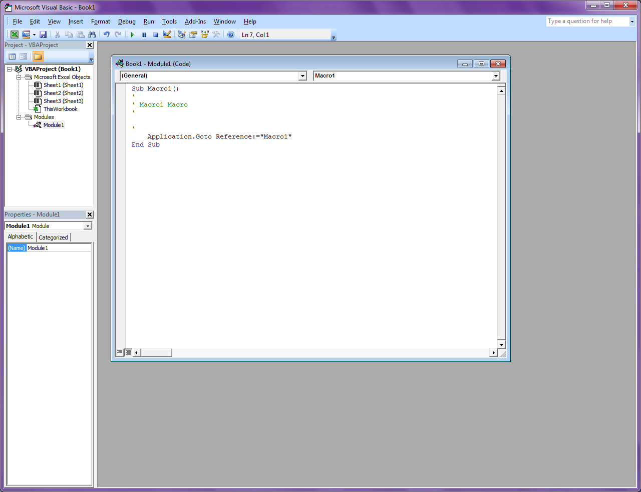
Record and Edit

Slide 10
Save Macros
Macros saved to workbook are only available within that workbook
Macros saved to Personal Workbook are available within the software program itself
The Personal Workbook is hidden and to make edits to macros stored there, it must first be unhidden from the toolbar

Slide 11
Save Macros, cont.
A file with Macros will not save with the normal .xls or .xlsx extension
It will prompt you to save with the .xlsm extension (Excel – Macro Enabled Workbook)

Slide 12
Run a Macro
Macros can be run manually from the menu
They can also be set to run automatically after another action, such as opening a workbook
Macros can be set to run after clicking on a button

Slide 13
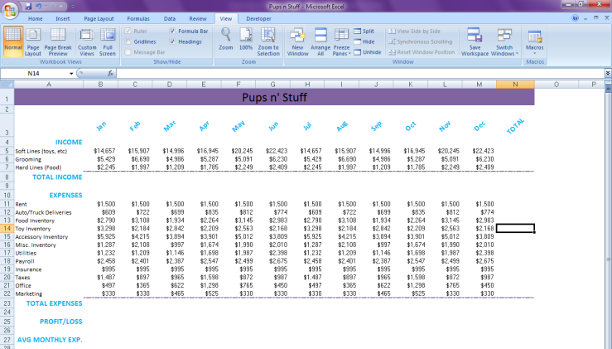
Macros In Action – Ex. #1
Add another year and delete all the totals!
View tab – Record Macros in Workbook
Go through the process of adding formulas to the 2011 sheet…formatting to.
All done –
stop recording.

Slide 14
Macros in action – Ex. #1
Copy the 2010 data to a new sheet, creating a sheet for 2012.
Delete all of the totals.
Run Macro!

Slide 15
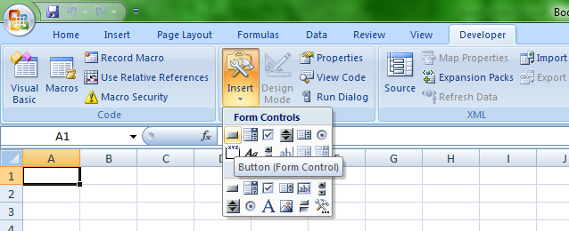
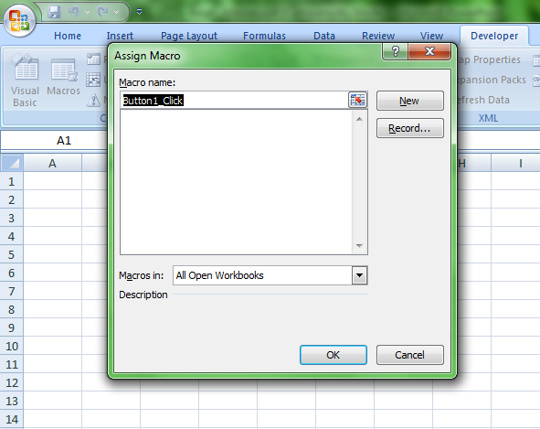
Example…Assign to a Button

Slide 16
Pivot Tables
A pivot table is an advanced data summarization and evaluation tool
Sorting, totals, filters, counts and more can be automatically calculated
Graphical properties make it user-friendly; drag and drop tools

Slide 17
Pivot Tables, cont.
There are multiple formatting options available for the table (with or without totals)
Formatting (colors and shading) can be applied manually or provided formats can be applied

Slide 18
Create a New Pivot Table
Pivot Tables are based on source data
Created from the Insert Tab
Range of data to be included can be selected by clicking on the red arrow
Can appear on the same sheet as the data or on a new worksheet – It is best to create on a new worksheet
Any changes made to formatting or cells outside the pivot table can be overwritten by the pivot table

Slide 19
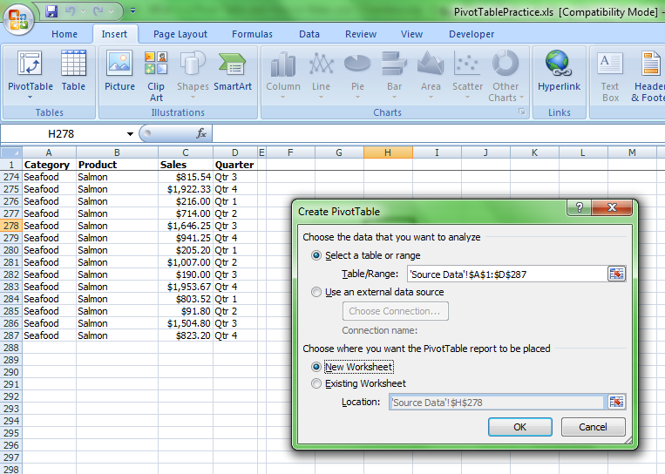


Slide 20
Drag & Drop
Column/Row data has been separated
Data values are able to be turned on/off
Drag and Drop the data options into the appropriate areas of the Pivot Table (Row, Column, Data)
Order matters

Slide 21
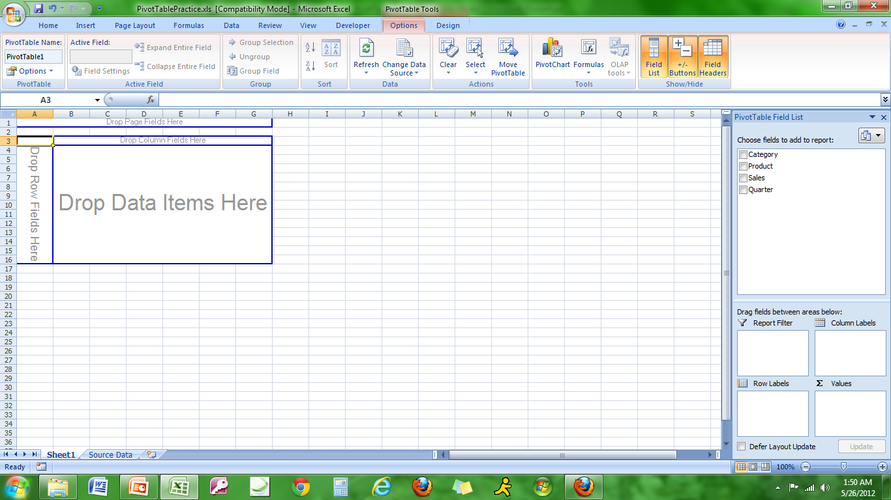
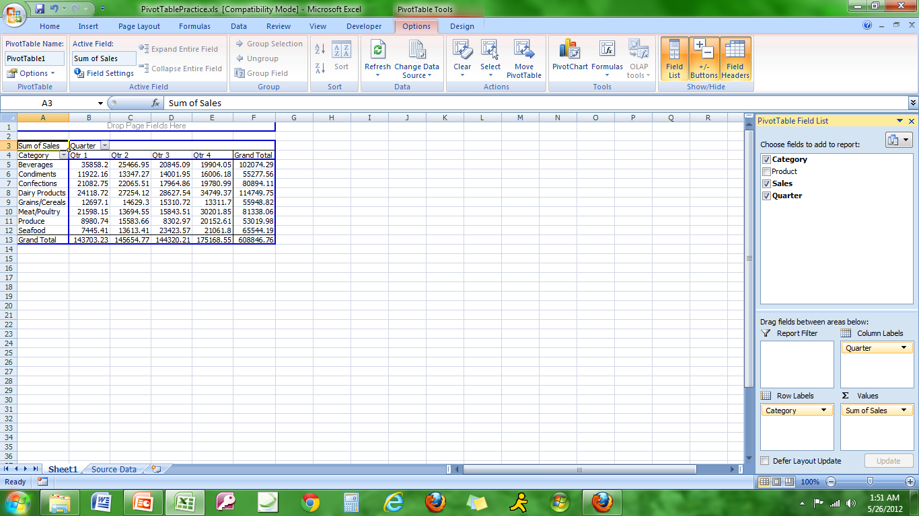

Slide 22
Drag & Drop, cont.
As more fields are added, the data can be expanded or contracted so more or less is viewable
Concurrently, grand totals and sub totals can be shown or not shown

Slide 23
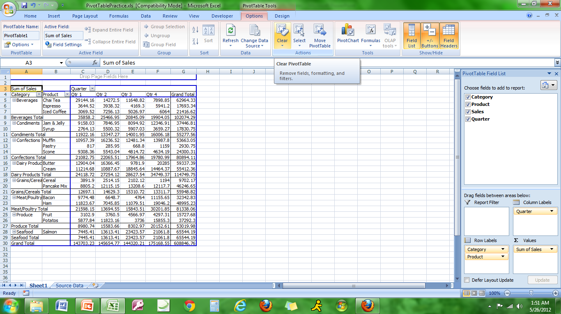

Slide 24
Pivot Table – Data Analysis
Row and Column headings can be swapped to analyze data in different ways
The data can be expanded and contracted to analyze at macro and micro levels
Trends can become visible as well as specific instances

